Slide 1


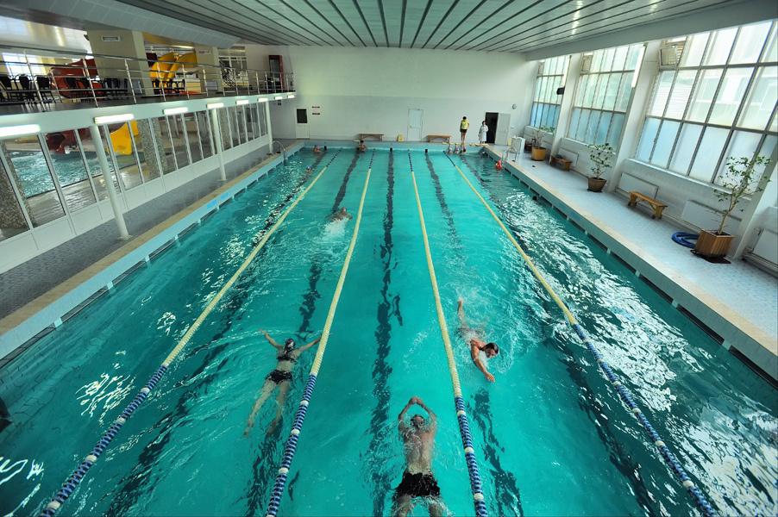
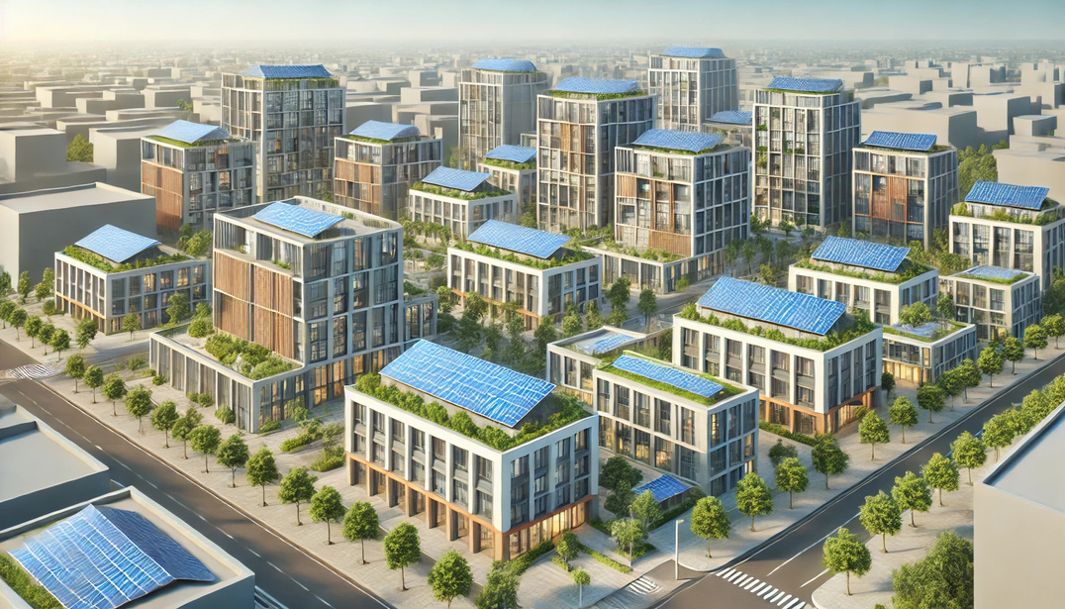
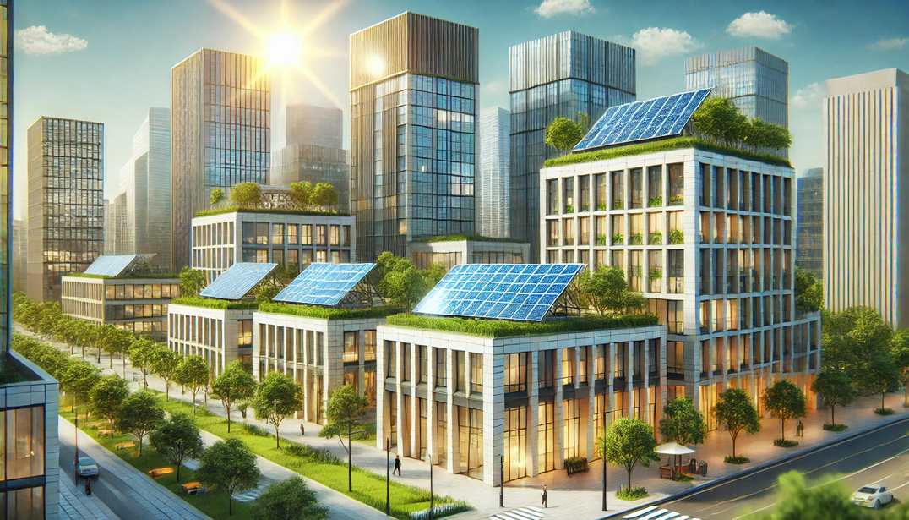



Solar stations on the buildings of the
municipal institutions

Slide 2

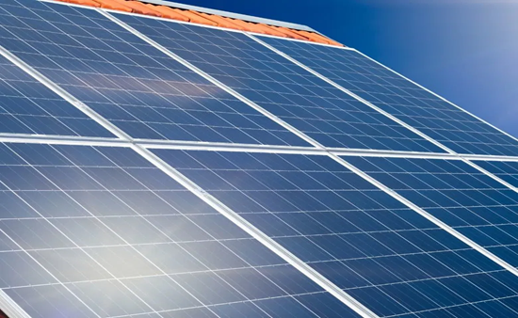











Solar stations on the buildings of the
municipal institutions
Project Objectives:
4 administrative buildings of the executive bodies of the Council
Solar power stations with a capacity of 70 kW each
Energy diversification:
expansion of the types of used energy resources
Cost reduction:
decreasing the city budget expenditures for traditional energy sources
Reduction of CO2 emissions:
achieved through decreased usage of energy from fossil sources
Energy independence:
improving energy independence indicators during the war and blackouts
The total cost of the project is
≈ 280 000 EUR

Slide 3






Solar stations on the buildings of the
municipal institutions
Expected Results:
reduction in energy intensity indicators
increase in energy independence
decrease in expenses for heating supply
increase in the share of renewable energy sources in the municipal sector
multiplication of results in other sectors of the municipal sector
promotion of the economic, environmental and social benefits of effectively usage of alternative energy
Savings: approximately 318 000 kWh per year

